Slide 1


Supporting successful next steps
Parents’ Information Evening

Slide 2

Parent Information:
Good habits
Getting stuff done
Goals and systems

Slide 3

UCAS 2025-26
Parent Information

Slide 4
What is UCAS?
UCAS is an independent charity providing information, advice and admissions services.
Higher education
Apprenticeships
Studying abroad
Gap year
Getting a job

Slide 5
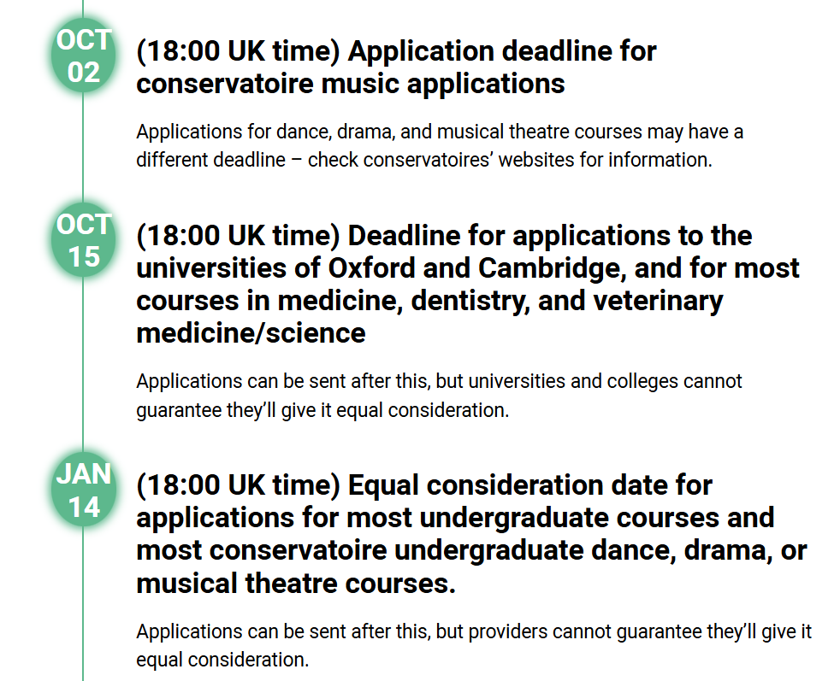
When to apply 2026 entry
We aim for all our students to have completed their applications by October half term with all applications sent off by early December

Slide 6
Key facts
Students pay for their application with a debit card just like any other online payment.
16-19 bursary scheme- students who are eligible for this are able to cover the cost through their bursary.
Start your application from May
Universities and colleges can’t see your other choices when you apply.
Apply by the equal consideration date.
Five choices, unless applying to study medicine, veterinary, medicine/science, dentistry – then it’s four choices.
You can’t apply to both Oxford and Cambridge.
Applying costs £28.95.

Slide 7
Choosing the right place to study
Style – from traditional, with a focus on subject-based courses and research, to modern universities/colleges, with a greater focus on vocational courses.
Location – some are in large cities, others in small towns, by the coast or in the countryside – it’s all a major influence on the environment and lifestyle.
Size – larger universities can have more than 20,000 students, whereas some of the smallest have only a few thousand.
Culture and facilities – influenced by a range of factors, including the diversity of students who attend.
What graduates do – all universities collect destination statistics; it can be useful to find out what jobs or further study students go on to.
Tuition fees – can vary between universities and colleges; check if there are scholarships or bursaries available.
Living costs – accommodation, transport, and food can vary enormously.

Slide 8
Choosing the right course to study
What does the course cover?
Courses with the same title may be very different.
Look carefully at the core course content, and the range of optional studies/modules available.
Which modules are the most interesting and relevant to your career aspirations?
See if the course or university/college offers any internship, placement, or study abroad opportunities.
How is the course taught – structured teaching, or more independent research? How many lectures are there, and how much group work will be done in seminars?
How is the course assessed?

Slide 9
Completing the UCAS application
All students’ applications are checked by the Sixth Form Team before being sent off to UCAS. We sit down with the student and review their application- checking the course they have applied for, the entry requirements needed in comparison to their predicted grades & go through their reference. Students are also asked to review their application for a final time independently and sign a consent form before we send it off.
Student registers for a UCAS Hub account to carry out research and start application.
Student completes all sections of the application and sends it to their school/college.
Teacher or adviser reviews the application and adds reference and predicted grades.
Applications are sent to UCAS by the school or college on behalf of the student.
Universities and colleges make their decisions on the application.
Security marking: PUBLIC
24 September 2025
| 9

Slide 10



Decisions
Universities and colleges will review the:
They may also ask for:
personal statement
admissions test
qualifications
interview
reference
portfolio/audition
Security marking: PUBLIC
24 September 2025
| 10

Slide 11
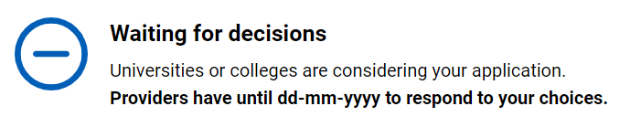
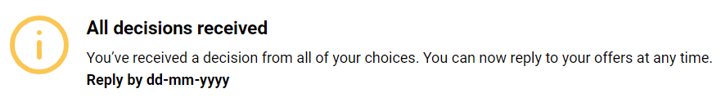
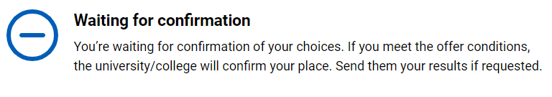
Tracking applications
Students can follow their application 24/7:
see their choices
keep contact information up to date
view and reply to their offers
They’ll receive one of three decisions from your choices:
unconditional offer
conditional offer
unsuccessful
Security marking: PUBLIC
24 September 2025
| 11

Slide 12

Replies to offers
Once they have decisions on all their choices, they can choose two:
  One as a ‘firm’ acceptance – their first choice.
  The other as an ‘insurance’ acceptance. This acts as a back-up if they do not get into their ‘firm’ choice.
Any remaining offers must be declined.
Once all their decisions and replies have been made, if they are not holding an offer, they may be able to use Extra or Clearing to find available places.
Security marking: PUBLIC
24 September 2025
| 12

Slide 13

What can students be doing?
research, research, research
attend open days and events
extracurricular and super curricular activities
work experience
volunteering
independent learning outside the curriculum
focus on this year’s studies
Security marking: PUBLIC
24 September 2025
| 13

Slide 14

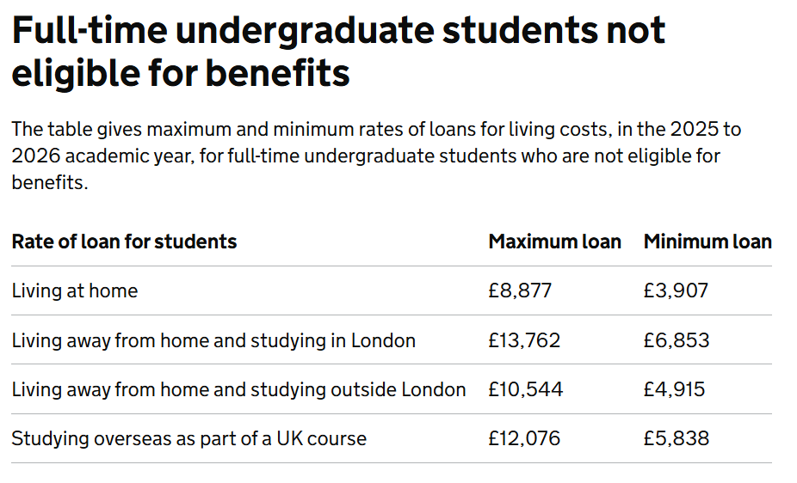
Student finance
Students can use the student finance calculator to estimate their Maintenance Loan.​
https://www.gov.uk/student-finance-calculator

Slide 15
Student finance
Repaying student loans
Students only repay their student loan when their income is over the threshold amount for their repayment plan.
The threshold amounts change on 6 April every year: at the moment this is when their income is over £26,900 a year
The earliest students will start repaying is the April after they leave their course
Repayments automatically stop if either:
they stop working
their income goes below the threshold.
Notes:
Students will be on Plan 2- when looking at the student finance website info.

Slide 16
Student finance
Students apply through the government website towards the end of February.
Apply straight away to ensure that the loans are available when students start their courses.

Slide 17
Student finance
For further information:
Student finance in England - Everything you need to know (ucas.com)
There is lots of really useful information on the UCAS website so please have a look at this.
Notes:
Please encourage students to have a look at this I their own time but also show them the website & highlight where to look- info on full-time students

Slide 18
Considering other
Post-18 options

Slide 19
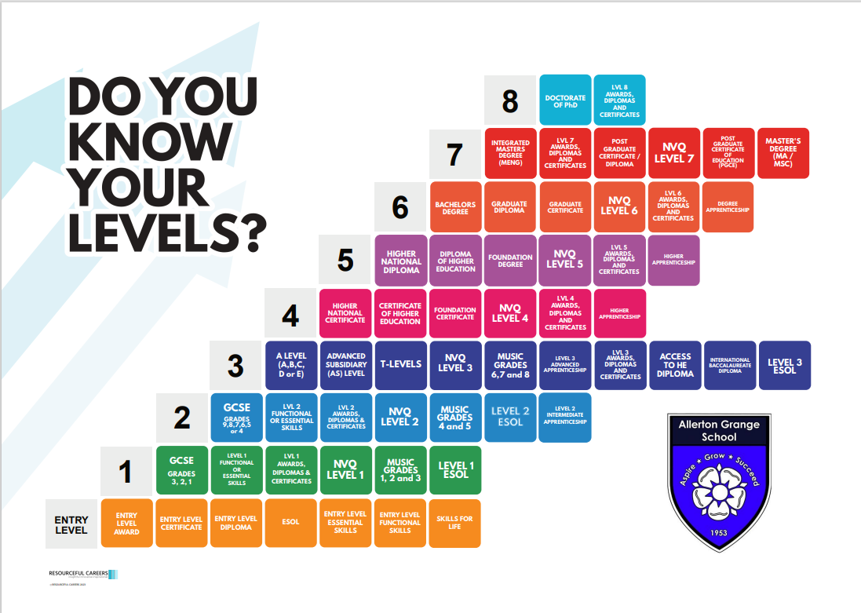

Slide 20

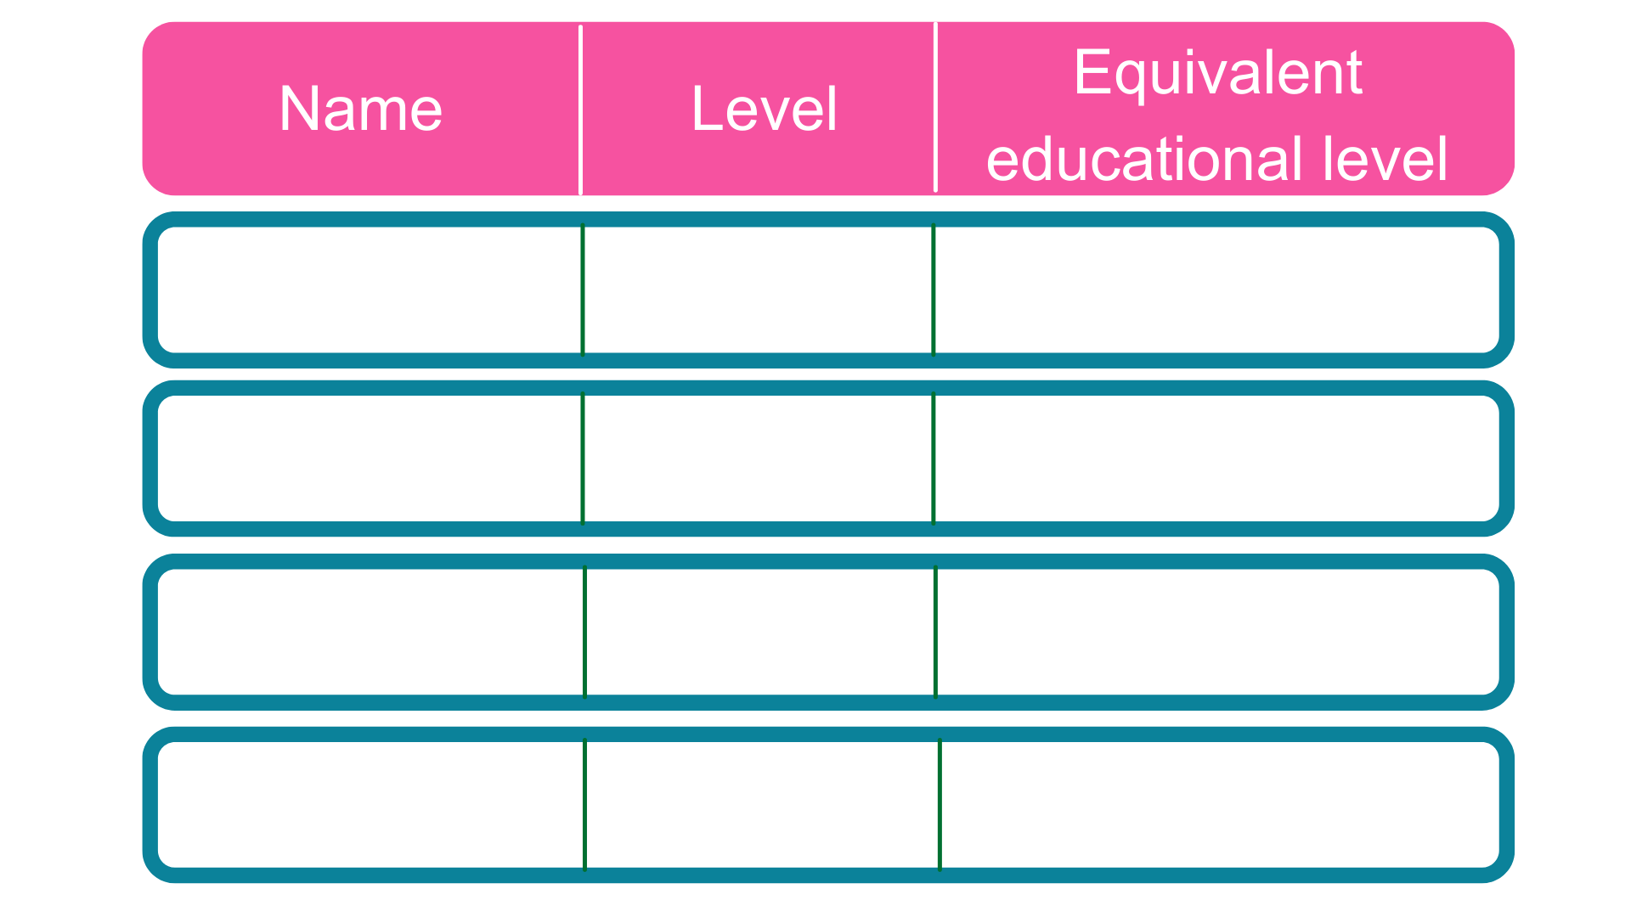
Intermediate
5 GCSE passes at grade A*-C or 4-9
2
2 A Levels / Level 3 diploma / International Baccalaureate
3
Advanced
Higher
Foundation degree and above
4,5,6 & 7
Degree
Bachelor’s or master’s degree
6 & 7
Notes:
Each apprenticeship has a level which will fall into one of the four categories above: Intermediate apprenticeships, Advanced apprenticeships, Higher apprenticeships and Degree apprenticeships.
The equivalent educational level column helps to explain what level the qualification at the end of the apprenticeship will be in comparison to more familiar qualifications, like GCSEs and A Levels.
So you can see that if you do a level 3 (advanced) apprenticeship, once you have qualified you’ll have gained a qualification that is equivalent to 2 A Levels, a level 3 diploma or other equivalents, like IB’s or BTECs.
Presenter notes: Opportunity to pause to ask if there are any questions about levels and how they work.
The level of apprenticeship you start at will depend on the kind of job that you are applying for.
It’s really important not to be held back by only looking for a particular level e.g. degree apprenticeships. Apprenticeships work a bit differently to school which can be confusing, as lots of students think that they should progress onto the next level, so if you leave after GCSEs you should do a Level 3 and if you finish after A Levels you should go for a degree apprenticeship, but this isn’t always the case.
Depending on the sector and apprenticeship, it may be that you need to start at advanced or higher level and work your way up, or that brilliant apprenticeships are only offered at Level 2 or 3 – for example, Journalism is only offered at Level 3 because that is all the industry requires.
Equally, you may be entering a completely new sector or industry that you haven’t studied or worked in before, and so may need to do a Level 2 or 3 to enter the world of work and get that understanding.
Doing a job is completely different to getting a GCSE or A Level and that’s why it can be a bit confusing.
It is very important to keep an open mind so that you can explore all of the opportunities available and have multiple options available when applying.

Slide 21





























Notes:
Presenter notes: Please update this slide with local companies if you feel that the logos are not representative of your area. Please include small and large organisations.
Equally, the range of employers offering apprenticeships is incredible.
This slide shows you some really familiar logos of big companies in England who all recruit apprentices.
Some of these employers may not be recruiting currently, but you will be able to track their recruitment updates on their websites or social media.
Around 50% of apprenticeships started are with large companies like this, but 50% will be with smaller local companies.
It can be tempting to think that the ‘best’ apprenticeships are just with the big, well-known companies, but many of the smaller employers have absolutely brilliant schemes that enable fast-track career progression for their apprentices, so it’s really important to do your research and not to ignore smaller employers because they can be just as good.
Presenter notes: Please include an example of a local company in the town that you are delivering in.
An example of a small local company is…X who employs apprentices in job roles like X and X etc.

Slide 22

Job opportunity | Level | Annual salary or weekly pay
GEOTECHNICAL ENGINEER (INTERGRATED) APPRENTICESHIP | 7 | £30,000
Degree Apprentice Development Chemist | 6 | £19,000
Environmental Health Apprenticeship | 6 | £12,313.60 to £22,010.56
Optical Apprentice | 3 | £13,312.00 to £23,795.20
RAF Firefighter | 3 | £21,091
Apprentice Adult Care Assistant | 2 | £9,984
Notes:
Presenter notes: We would expect this slide to be updated by the delivery partner to reflect local opportunities by searching through Find an Apprenticeship
So as I said before, I had a look on the Find an apprenticeship website before coming along today so that I could see how many vacancies are out there at the moment.
If you notice, within 5 miles of this school/college today, there are xx vacancies.
You can see how this number grows the more you increase the distance.
You will need to think about how far you are prepared to travel for work each day.
If you want to think about working in the (insert name of an appropriate town/city), then you could be looking for vacancies there.
The one rule is that you will need to be able to get there, on time, every day.
Remember, it is important not to restrict your searches for vacancies to just look at large companies as many small employers offer some excellent vacancies with great packages and career progression opportunities.
It is also important to do some wider research and look in lots of places for apprenticeships, which we will discuss more on shortly.

Slide 23
Where/how to find an apprenticeship
The million dollar question!
In truth, they are not an easy route at all, they are much more competitive than university and they’re not always easy to find.
  Job search sites, such as Reed, Indeed and Linkedin are often used by large companies.
  The government website has a lot of apprenticeship opportunities.
  UCAS website.
  Amazing Apprenticeships website.

Slide 24
The application process
Will vary for each apprenticeship
May include psychometric testing
Will consist of either an online interview, an in-person interview, or both (in addition to applications forms).
Assumes you’ve done your research!
Companies are now starting recruitment as early as September.

Slide 25




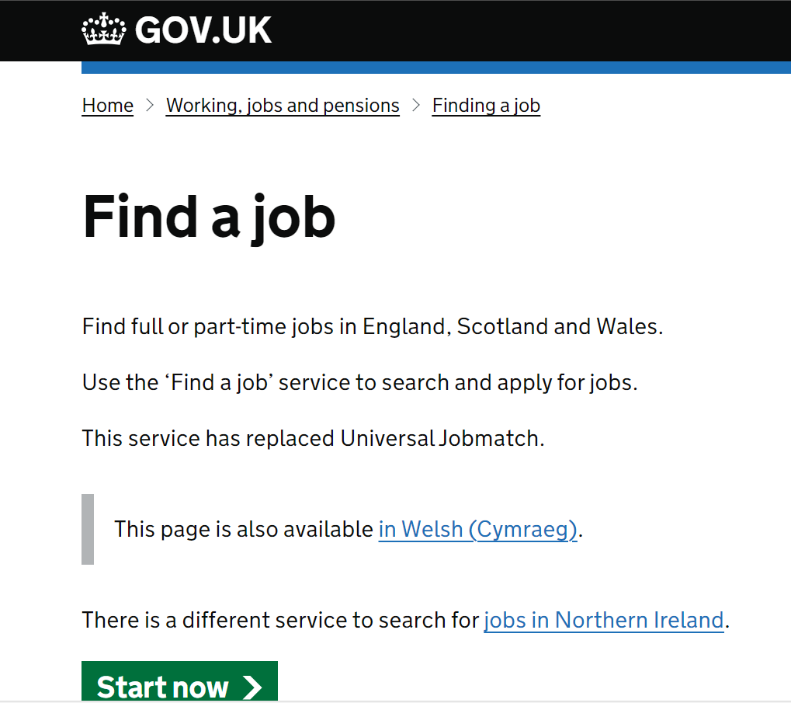


Want a job rather than an apprenticeship. Here are a few places to look…

Slide 26
For jobs and apprenticeships students need…
An up-to-date CV with an impactful opening statement.
A polite and professional email manner.
A letter of application or personal statement (for some, others will have a series of questions for students to answer)
Names and email addresses of 2 references (one can be school, the other should be a previous employer or family friend).

Slide 27
Top tips
It may take 50-100 applications to be successful, so persevere!
It is time consuming, so setting aside some time regularly to search and apply is important.
Apply for Level 3 apprenticeships, they are a great way to get a foot in the door and many companies will then support you in moving onto a degree apprenticeship.
Sign up for alerts on all the apprenticeship sites suggested, you'll be the first to hear about new apprenticeships and can then be one of the first to apply!
Linkedin is a great resource! All students should be creating themselves a profile and starting to connect with people and companies in the field/s they are interested in.
Make use of Unifrog and UCAS (and Mrs Mills)!

Slide 28
Any questions?
We’ll be here to talk to you about any individual queries or concerns

Slide 29


Allerton Grange School
Talbot Avenue
Leeds LS17 6SF
Tel: 0113 393 0304
Email: sixthform@allertongrange.com
allertongrangeschool
@allertongrangeschool
www.allertongrange.com

